Slide 1
The Actor Model, its Verification and Approach to Fault Tolerance

Slide 2
Why care about Actors
Akka: SVT, Cisco, Ebay, Credit Suisse, BBC, Amazon, Blizzard, The Guardian, Walmart
Erlang: Ericsson, Motorola, Facebook, WhatsApp, Klarna, Goldman Sachs, T-Mobile, Telia
And the people at tele seems to like it.

Slide 3
Actor usage, for what?
Used mostly in communication
  Telecommunications
  Internet messaging and games
  Web
Also: High-frequency trading, energy trading, border patrol checking, cargo tracking

Slide 4
Actor usage, how?
Generally NOT single-machine, but actors distributed across several machines/data centers
Concurrency at country/global scale
Fault-tolerant - hardware failures expected
Also used for local concurrency, but the distributed philosophy sticks with the model

Slide 5
What is the actor model?
Hewitt, Bishop, and Steiger in 1973, Irene Greif in 1975

Slide 6
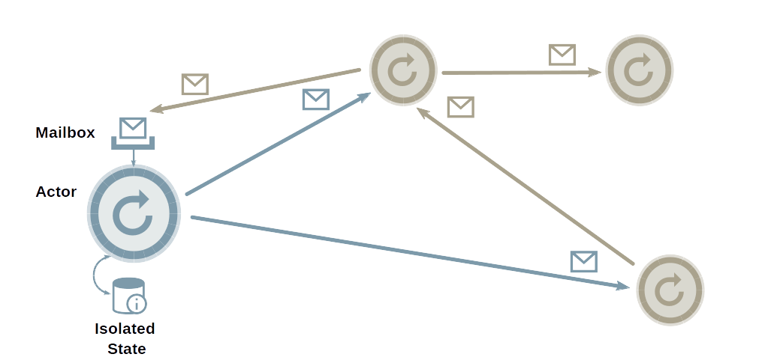
What is the Actor Model

Slide 7
Two modern implementations
Erlang
  Developed at Ericsson in 1986
  An entire language devoted to actors – each actor has own heap
Akka
  Developed at EPFL/Typesafe in 2009
  A library hosted on the JVM written in Scala, accessible from Java and Scala
    Not as pure-bred as Erlang – messages with references to shared memory illegal “by convention”

Slide 8

Verification is... hard.
Formal verification done running Spin (or equivalent) using bounded mailboxes
Problem: Bounded mailboxes not recommended and unusual (discouraged in Akka, you have to make your own in Erlang)
Actor systems usually distributed, so hardware and network (could be the Internet) must be assumed unreliable.

Slide 9
But fret not!
Race conditions impossible because of no shared memory (literally in Erlang, by convention in Akka)
Methods for preventing deadlock
  Waiting on answer not needed. One-off routine spawned to react to answer (Akka)
  Messages may be sent in order, but need not be processed in order (Erlang)
  If worst comes to worst all state can be held in messages and execution resumes as if the actor had waited on message when in reality it has processed other messages.

Slide 10
Attempts at formal methods
Actor Communicating System
SOTER (version: 0.1)[Oxford]
  Does reachability analysis but “problem is undecidable” - Unsafe means not proven Safe
McErlang[Politecnica Madrid]
Rebeca (last update 2012)[Tehran]

Slide 11
Byzantine Fault Tolerance
“How can you make a reliable computer service?” the presenter will ask in an innocent voice before continuing, “It may be difficult if you can’t trust anything and the entire concept of happiness is a lie designed by unseen overlords of endless deceptive power.” The presenter never explicitly says that last part, but everybody understands what’s happening. - From “The Saddest Moment” by James Mickens, Microsoft Research

Slide 12
Byzantine Fault Tolerance
Inspired by Byzantine Generals' Problem
Byzantine failures: Components in a system fail in arbitrary ways. Examples: Stopping, crashing, processing incorrectly, corrupting state and/or producing arbitrary outputs – welcome to distributed reliability
Solutions with forgeable messages can guarantee correctness if traitors make up less than one-third of system. The general idea is to treat messages as votes and agree with the majority
Cryptography-powered solutions can do much better – arbitrary number of traitors do not prevent remainder from agreeing. However, this is usually not necessary and computationally costly.
BitCoin uses a variant of this

Slide 13
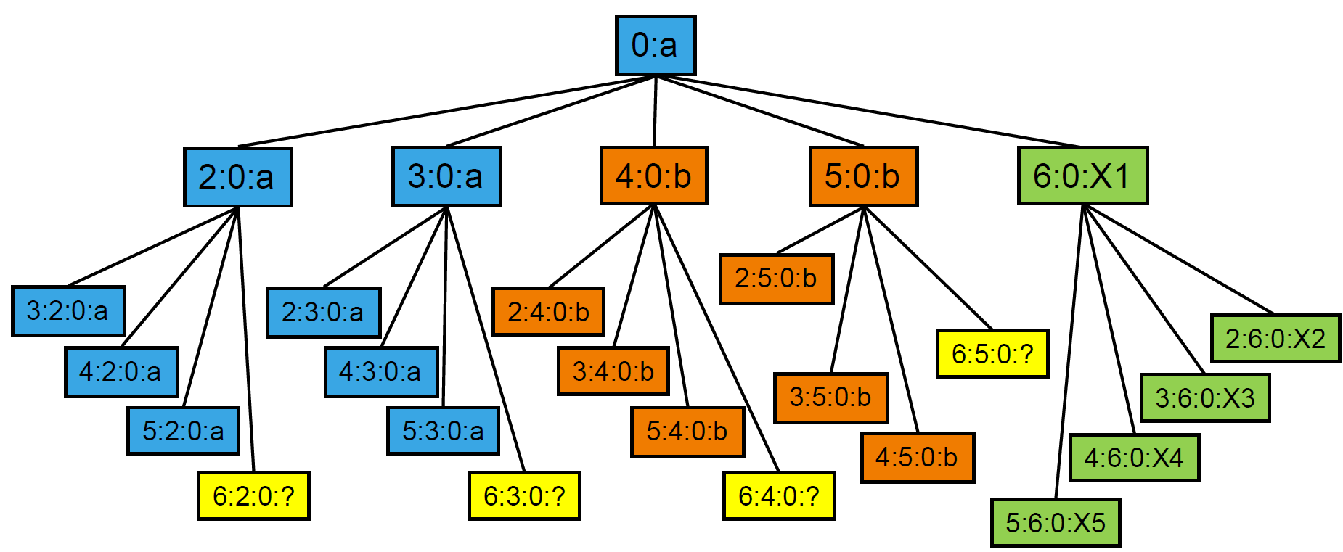
Byzantine Fault Tolerance
This is the view from lieutenant 1
Commander is 0; gives message a and b to different groups
Lieutenant 6 does its own thing
Image credit: Jan Richling, TU Berlin

Slide 14
Byzantine Fault Tolerance
JAMES: I announce my desire to go to lunch.
BRYAN: I verify that I heard that you want to go to lunch.
RICH: I also verify that I heard that you want to go to lunch.
CHRIS: YOU DO NOT WANT TO GO TO LUNCH.
JAMES: OH NO. LET ME TELL YOU AGAIN THAT I WANT TO GO TO LUNCH.
CHRIS: YOU DO NOT WANT TO GO TO LUNCH.
BRYAN: CHRIS IS FAULTY.
CHRIS: CHRIS IS NOT FAULTY.
RICH: I VERIFY THAT BRYAN SAYS THAT CHRIS IS FAULTY.
BRYAN: I VERIFY MY VERIFICATION OF MY CLAIM THAT RICH CLAIMS THAT I KNOW CHRIS.
JAMES: I AM SO HUNGRY.
CHRIS: YOU ARE NOT HUNGRY.
RICH: I DECLARE CHRIS TO BE FAULTY.
CHRIS: I DECLARE RICH TO BE FAULTY.
JAMES: I DECLARE JAMES TO BE SLIPPING INTO A DIABETIC COMA.

Slide 15
Let it crash
“It shifts the view to look at errors as something natural and something that will happen, instead of trying to prevent it; embraces it” - Akka doc
The restarts will continue until stability improves
Conventional response to any problem is to crash and restart – flushing all messages in mailbox and killing all actors further down in the hierarchy. Exceptions are not, in general, handled.

Slide 16
Supervisor Hierarchies
Automates the watchdog approach
Every actor has a supervisor whose responsibility it is to handle crashes, exceptions, kill children actors etc.
  Exceptions can be propagated up the chain so the supervisor can determine how many actors need to be restarted, because actors can be tightly coupled

Slide 17
Supervisor Hierarchies

